Slide 1
Transfer Learning

Slide 2
Marios Mattheakis
Robbert Struyven
Camilo Fosco
Vincent Casser

Slide 3

Workshop Overview for Session 2
Intro Lecture
10:00 - 10:30
Pavlos
Basic Transfer Learning
10:45 - 11:30
Marios
Transfer Learning Across Tasks
11:30 - 12:45
Robbert & Camillo
Weight and Biases
3:00 - 4:30
Chris & Carey
Network Distillation
1:45 - 2:45
Robbert & Camillo
Lunch
12:45 - 1:45

Slide 4

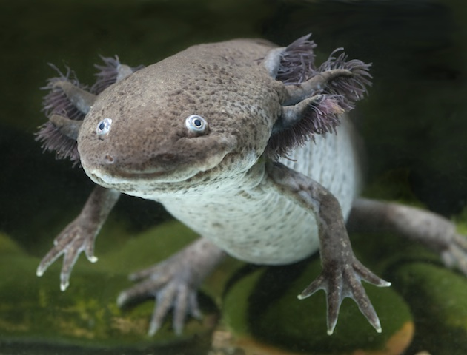
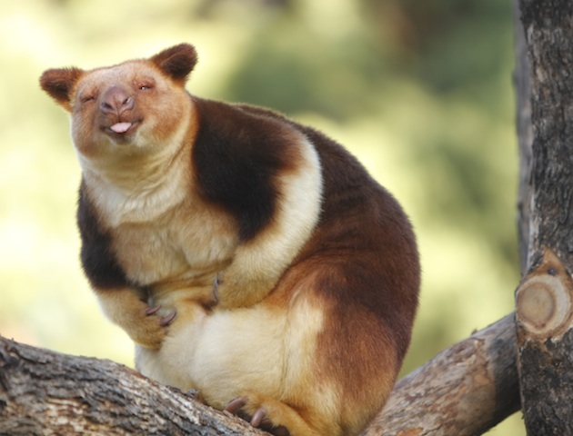
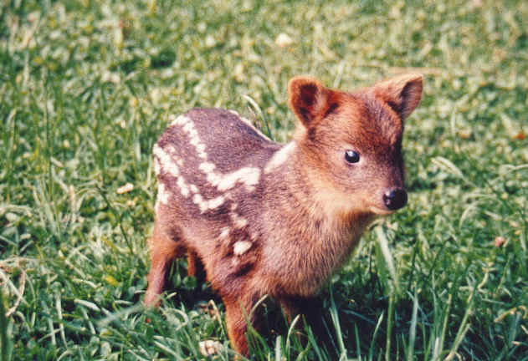
Classify Rarest Animals
VGG16
NOT ENOUGH DATA
Number of parameters: 134,268,737
Data Set: Few hundred images
Notes:
axolotl mexican, pudu

Slide 5
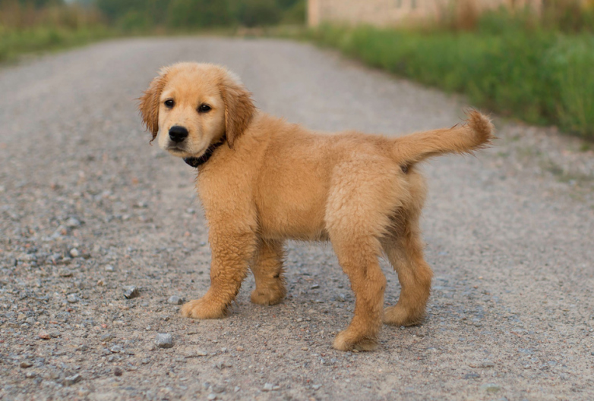
Classify Cats, Dogs, Chinchillas etc
VGG16
TAKES TOO LONG
Number of parameters: 134,268,737
Enough training data. ImageNet approximate 1.2M

Slide 6
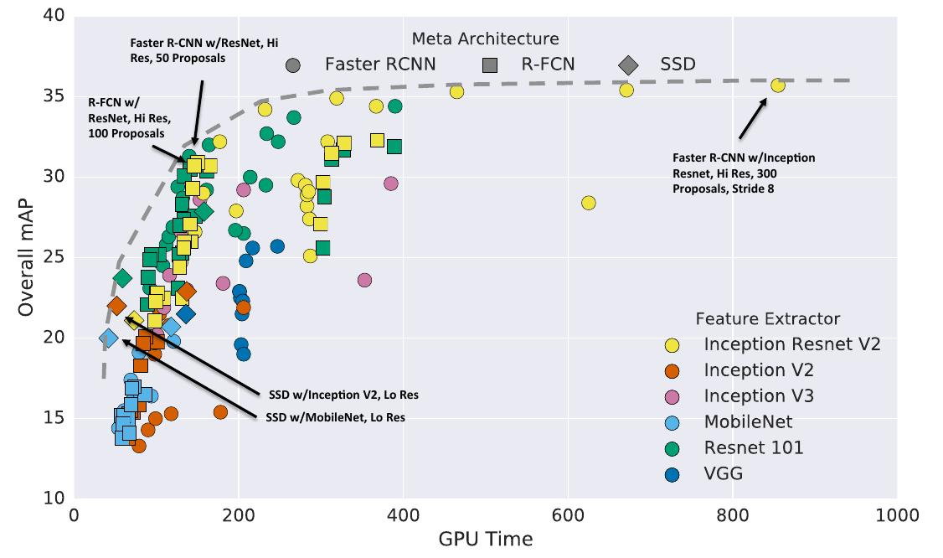

Slide 7

Transfer Learning To The Rescue
How do you build an image classifier that can be trained in a few minutes on a CPU with very little data?

Slide 8
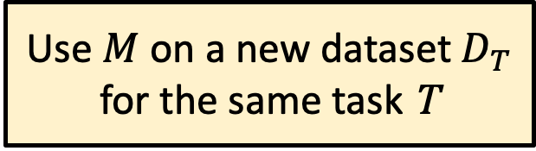
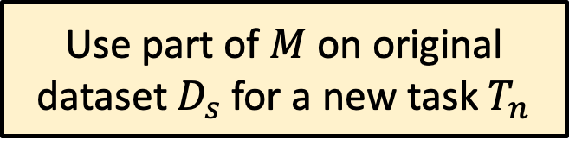
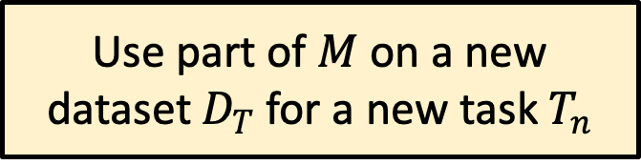
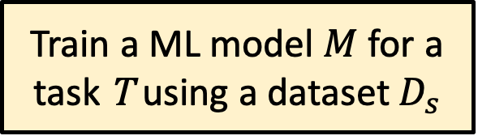
Basic idea of Transfer Learning
Train a ML model $M$ for a task T using a dataset $D_{s}$
Wikipedia:
Transfer learning (TL) is a research problem in machine learning (ML) that focuses on storing knowledge gained while solving one problem and applying it to a different but related problem.^{[1]}
Use $M$ on a new dataset $D_{T}$ for the same task T
Use part of $M$ on original dataset $D_{s}$ for a new task $T_{n}$
Use part of $M$ on a new dataset $D_{T}$ for a new task $T_{n}$

Slide 9
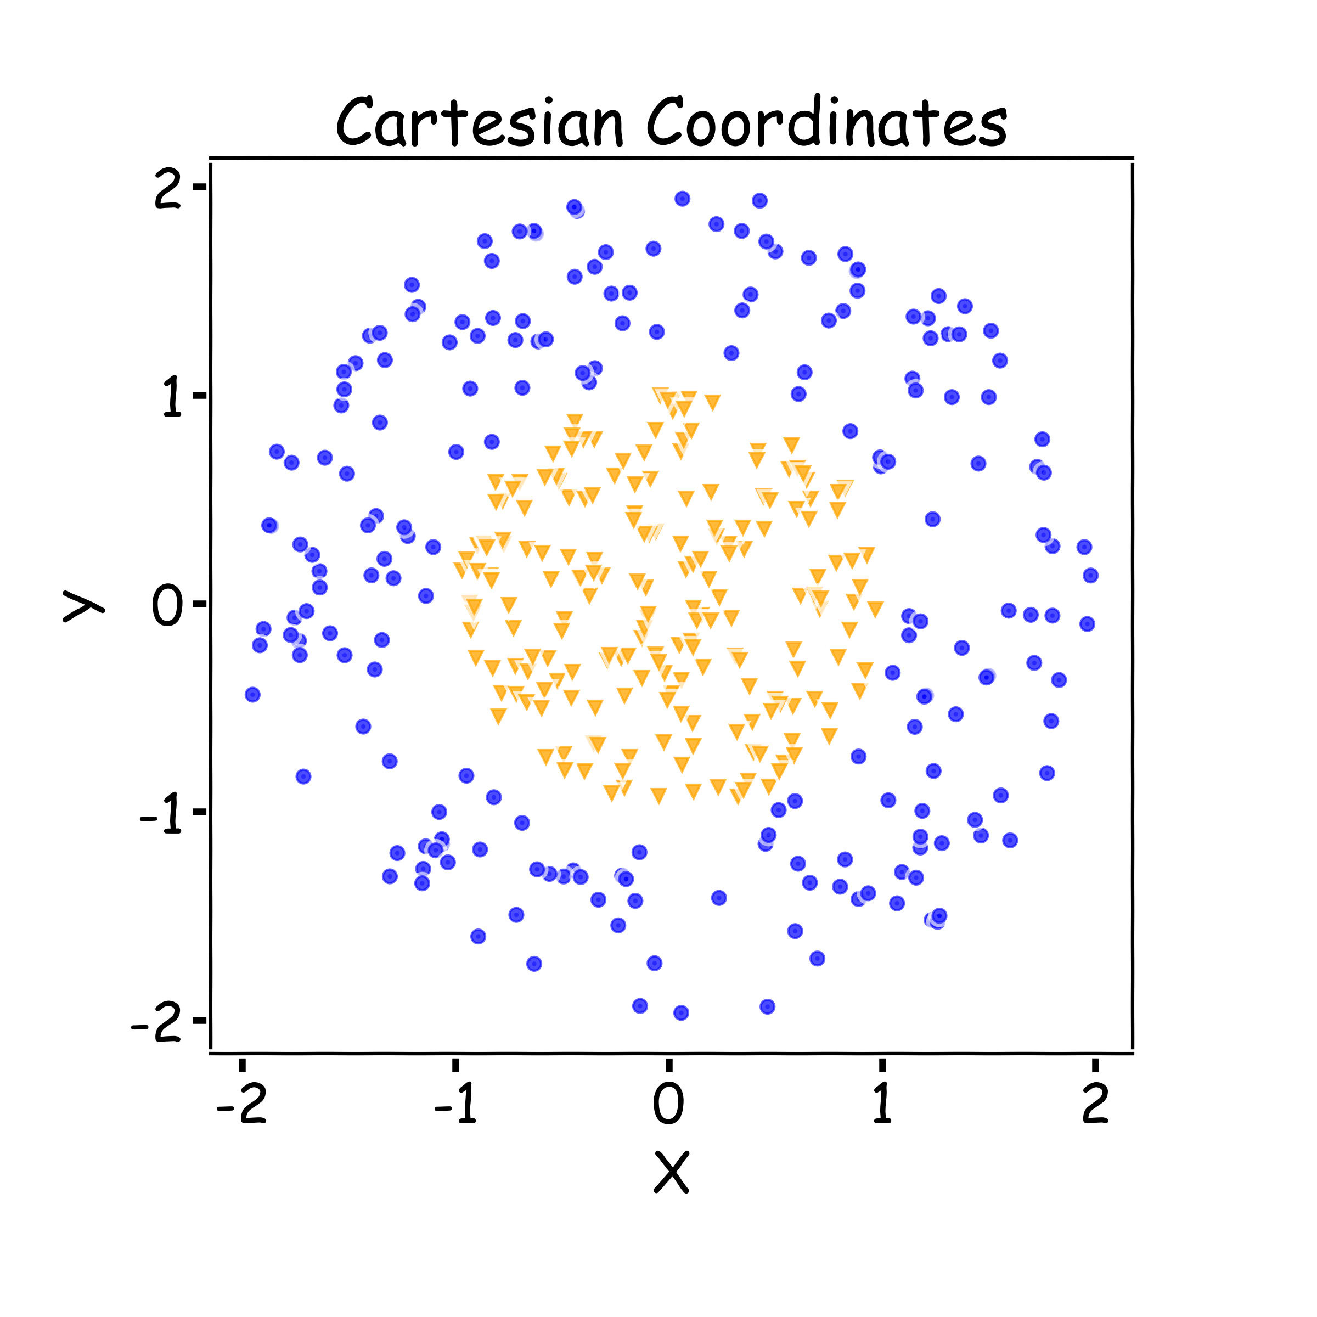
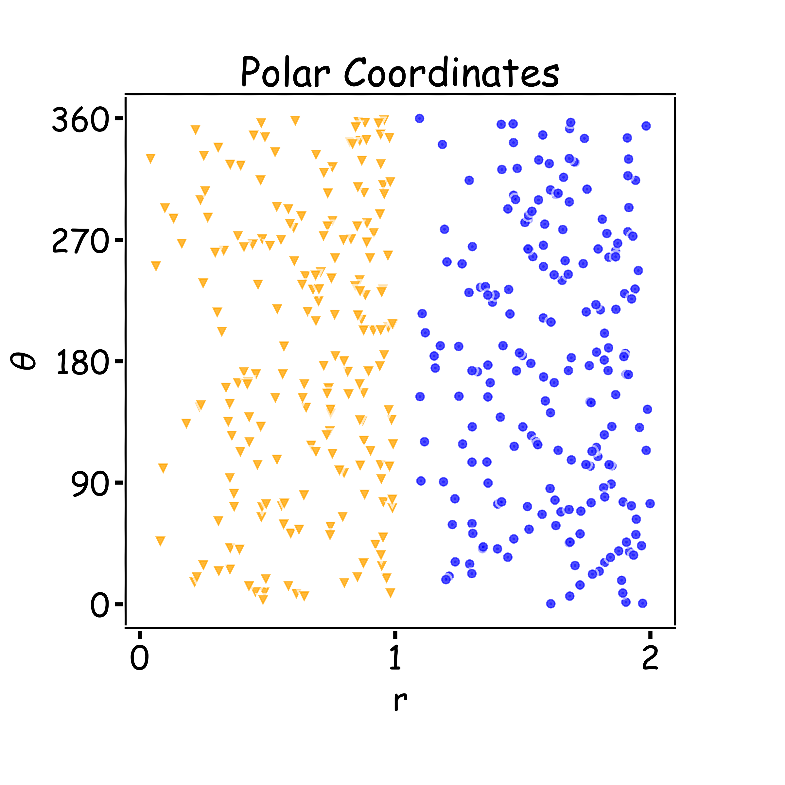
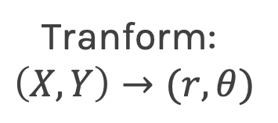
Key Idea: Representation Learning
Relatively difficult task
Easier task
Tranform:
$$\left(X,Y\right)→(r,θ)$$

Slide 10
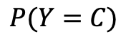
Representation Learning
Task: classify cars, people, animals and objects
FCN
CNN Layer 1
CNN Layer 2
CNN Layer n
…
$$P(Y=C)$$

Slide 11
Transfer Learning To The Rescue
How do you make an image classifier that can be trained in a few minutes on a CPU with very little data?
Use pre-trained models, i.e., models with known weights.
Main Idea: earlier layers of a network learn low level features, which can be adapted to new domains by changing weights at later and fully-connected layers.
Example: use ImageNet trained with any sophisticated huge network. Then retrain it on a few images

Slide 12
Transfer Learning
Pre-train network such as VGG, etc
Train only this
FCN
CNN Layer 1
CNN Layer 2
CNN Layer n
…
$$P(Y=C)$$

Slide 13
Transfer Learning
Pre-train network
Train this
FCN
CNN Layer 1
CNN Layer 2
CNN Layer n
…
$$P(Y=C)$$

Slide 14
Transfer Learning – fine tuning
Train everything but start with weights that are trained already
FCN
CNN Layer 1
CNN Layer 2
CNN Layer n
…
$$P(Y=C)$$

Slide 15
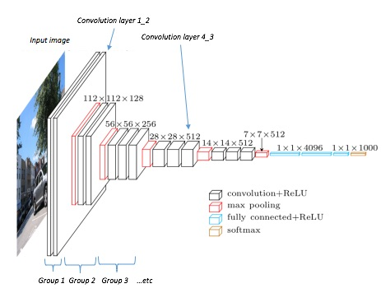
Transfer Learning Across Tasks
Classification:
P(cat)
P(chinchilla)
P(dog)
Object Detection:

Slide 16
Transfer Learning Across Tasks (cont)
Classification:
P(cat)
P(chinchilla)
P(dog)
Segmentation:

Slide 17
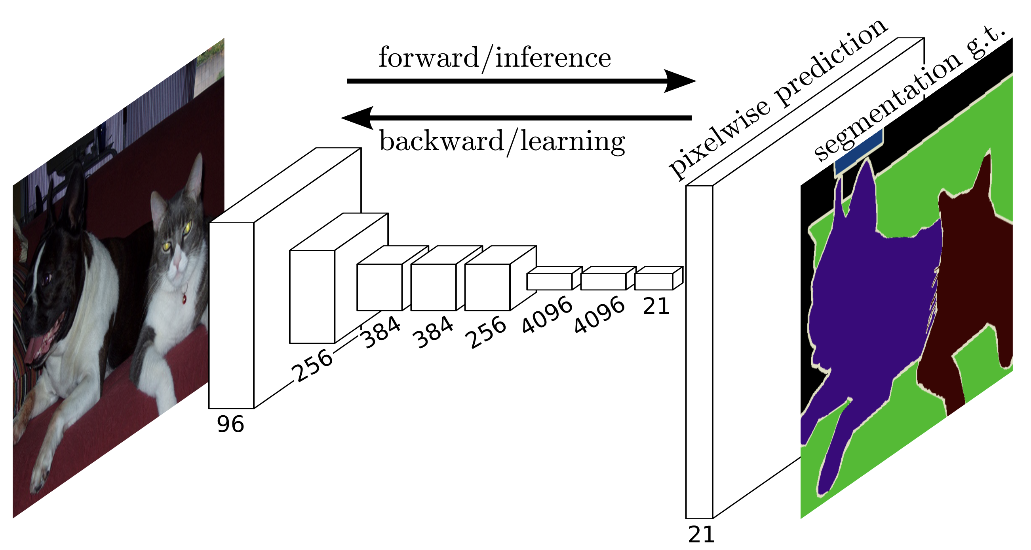
Segmentation

Slide 18
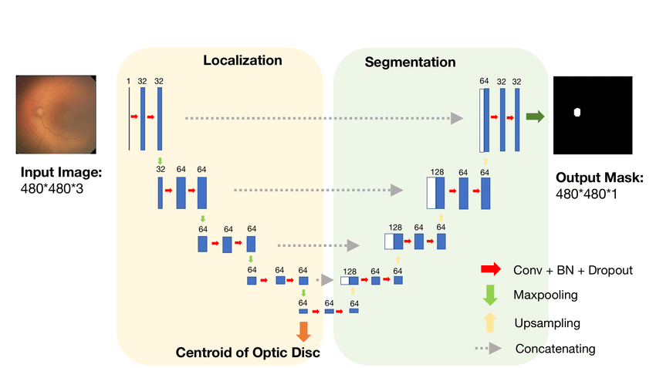
Segmentation: U-net architecture
Pre-train network
Train this
Notes:
U-Net consists of an almost symmetric encoder and decoder.
it has skip connections from the output of convolution blocks to the corresponding input of the transposed-convolution block at the same level: these skip connections allow gradients to flow more effectively and provides information from multiple scales of the image.

Slide 19
Segmentation (fine tuning)
Fine tune

Slide 20
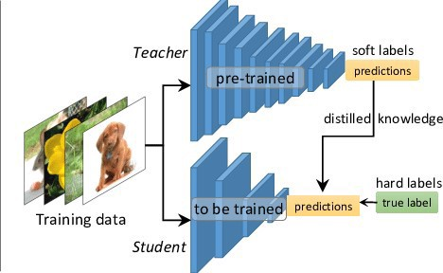
Transfer Learning through Network Distillation
Question: is it possible to distill and compress the knowledge of the large and complex training model (the teacher) into a small and simple deployment model (the student)?
Standard cross entropy with correct labels
Cross entropy with the output from the teacher network predictions

Slide 21
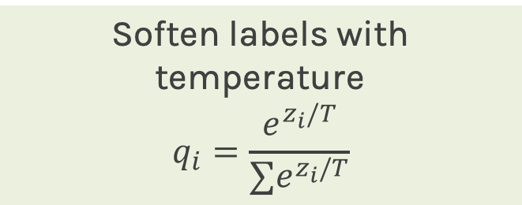
Transfer Learning through Network Distillation (temperature)
Standard cross entropy with correct labels
Soften labels with temperature
$$q_{i}=\frac{e^{z_{i}/T}}{∑e^{z_{i}/T}}$$
Cross entropy with the soft targets from the teacher network predictions

Slide 22
Workshop Overview for Session 2
Intro Lecture
10:00 - 10:30
Pavlos
Basic Transfer Learning
10:45 - 11:30
Marios
Transfer Learning Across Tasks
11:30 - 12:45
Robbert & Camillo
Weight and Biases
3:00 - 4:30
Chris & Carey
Network Distillation
1:45 - 2:45
Robbert & Camillo
Lunch
12:45 - 1:45

